Slide 1
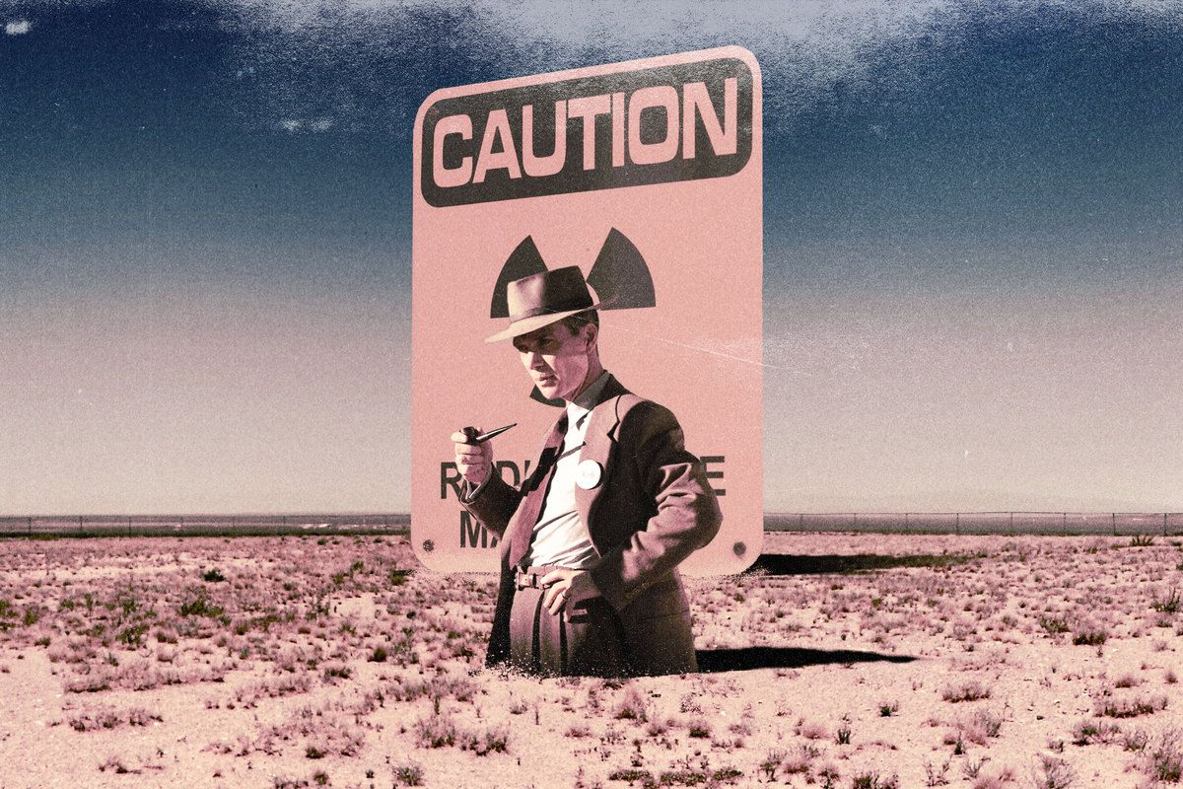
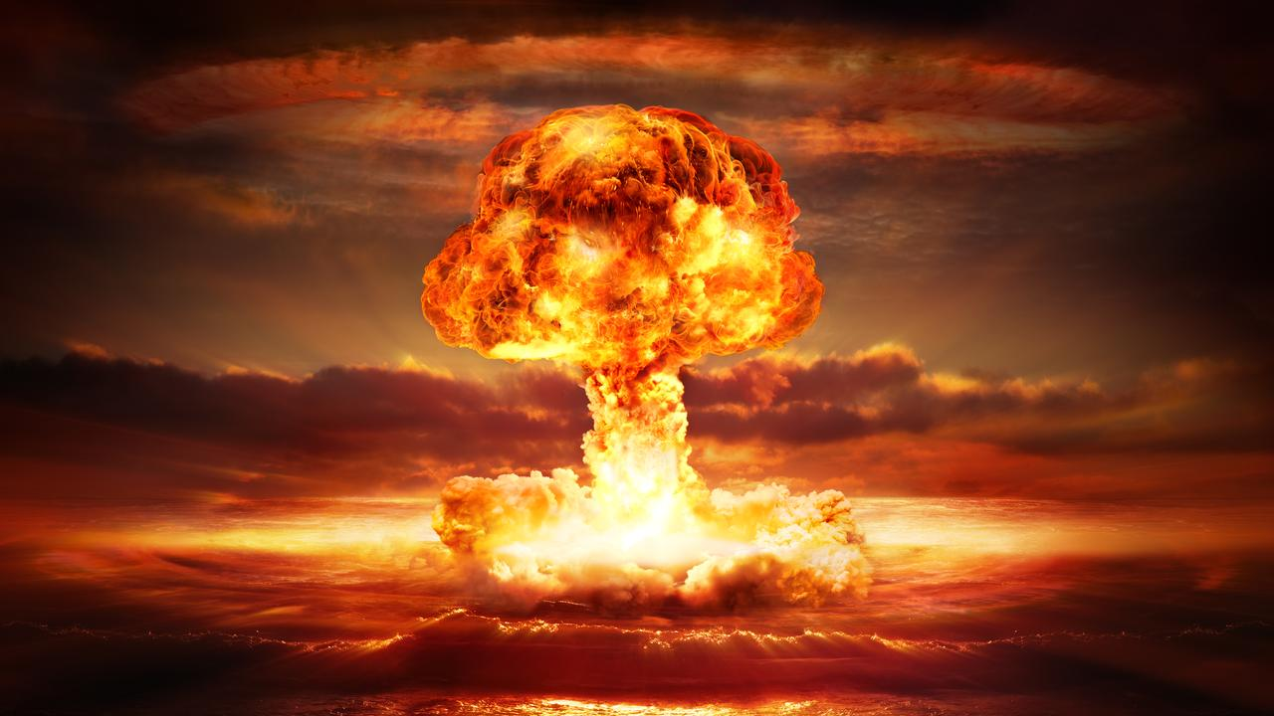
Theory will take you only so far
Notes:
No shade or hate to theorists but theory will take you only so far

Slide 2



Dude, how do you build a Magneto - Optical Trap?
Workshop May 06, 2024
Sukhman K. S.

Slide 3
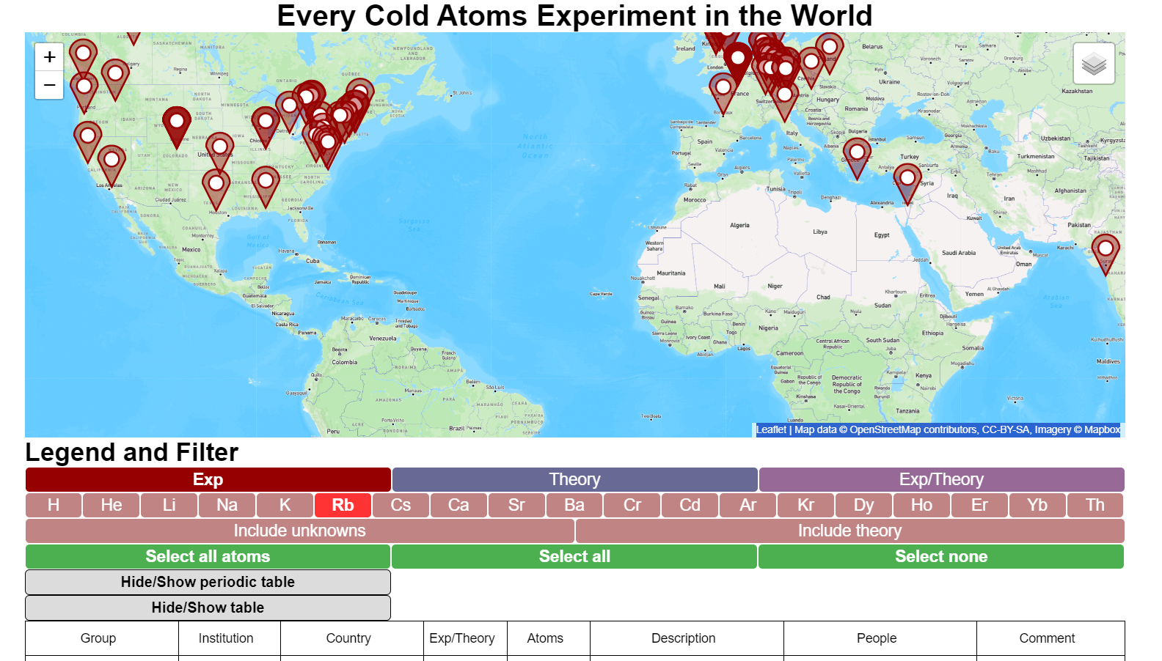
https://everycoldatom.com/

Slide 4
Outline
Cooling and Trapping: MOT beams – Optical Molasses
Vacuum System
Generating Quadrupole Magnetic Field
Limitations of MOT: Temperature, Density
Characterization and Optimization of MOTs: Thermometry, Imaging System
Notes:
Limitations of MOT: temperature, density [size V→ N=ρV, N determined by temp/v_capture]

Slide 5
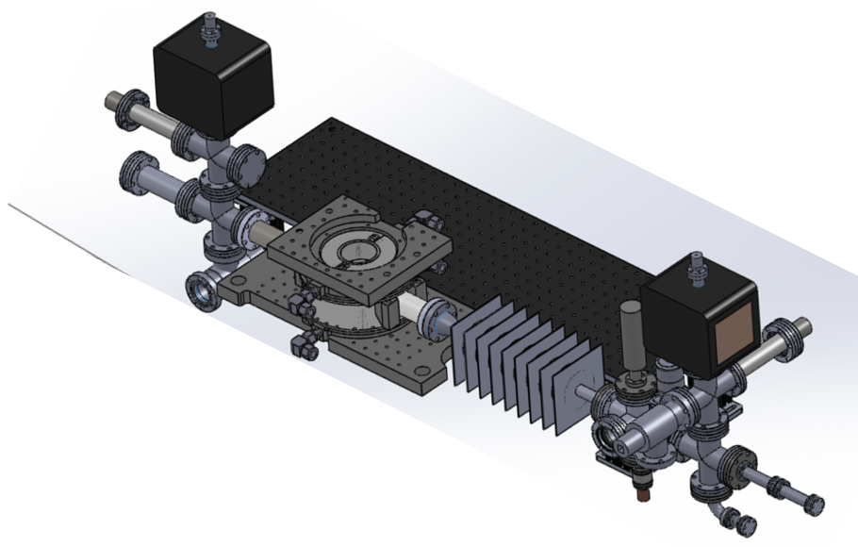
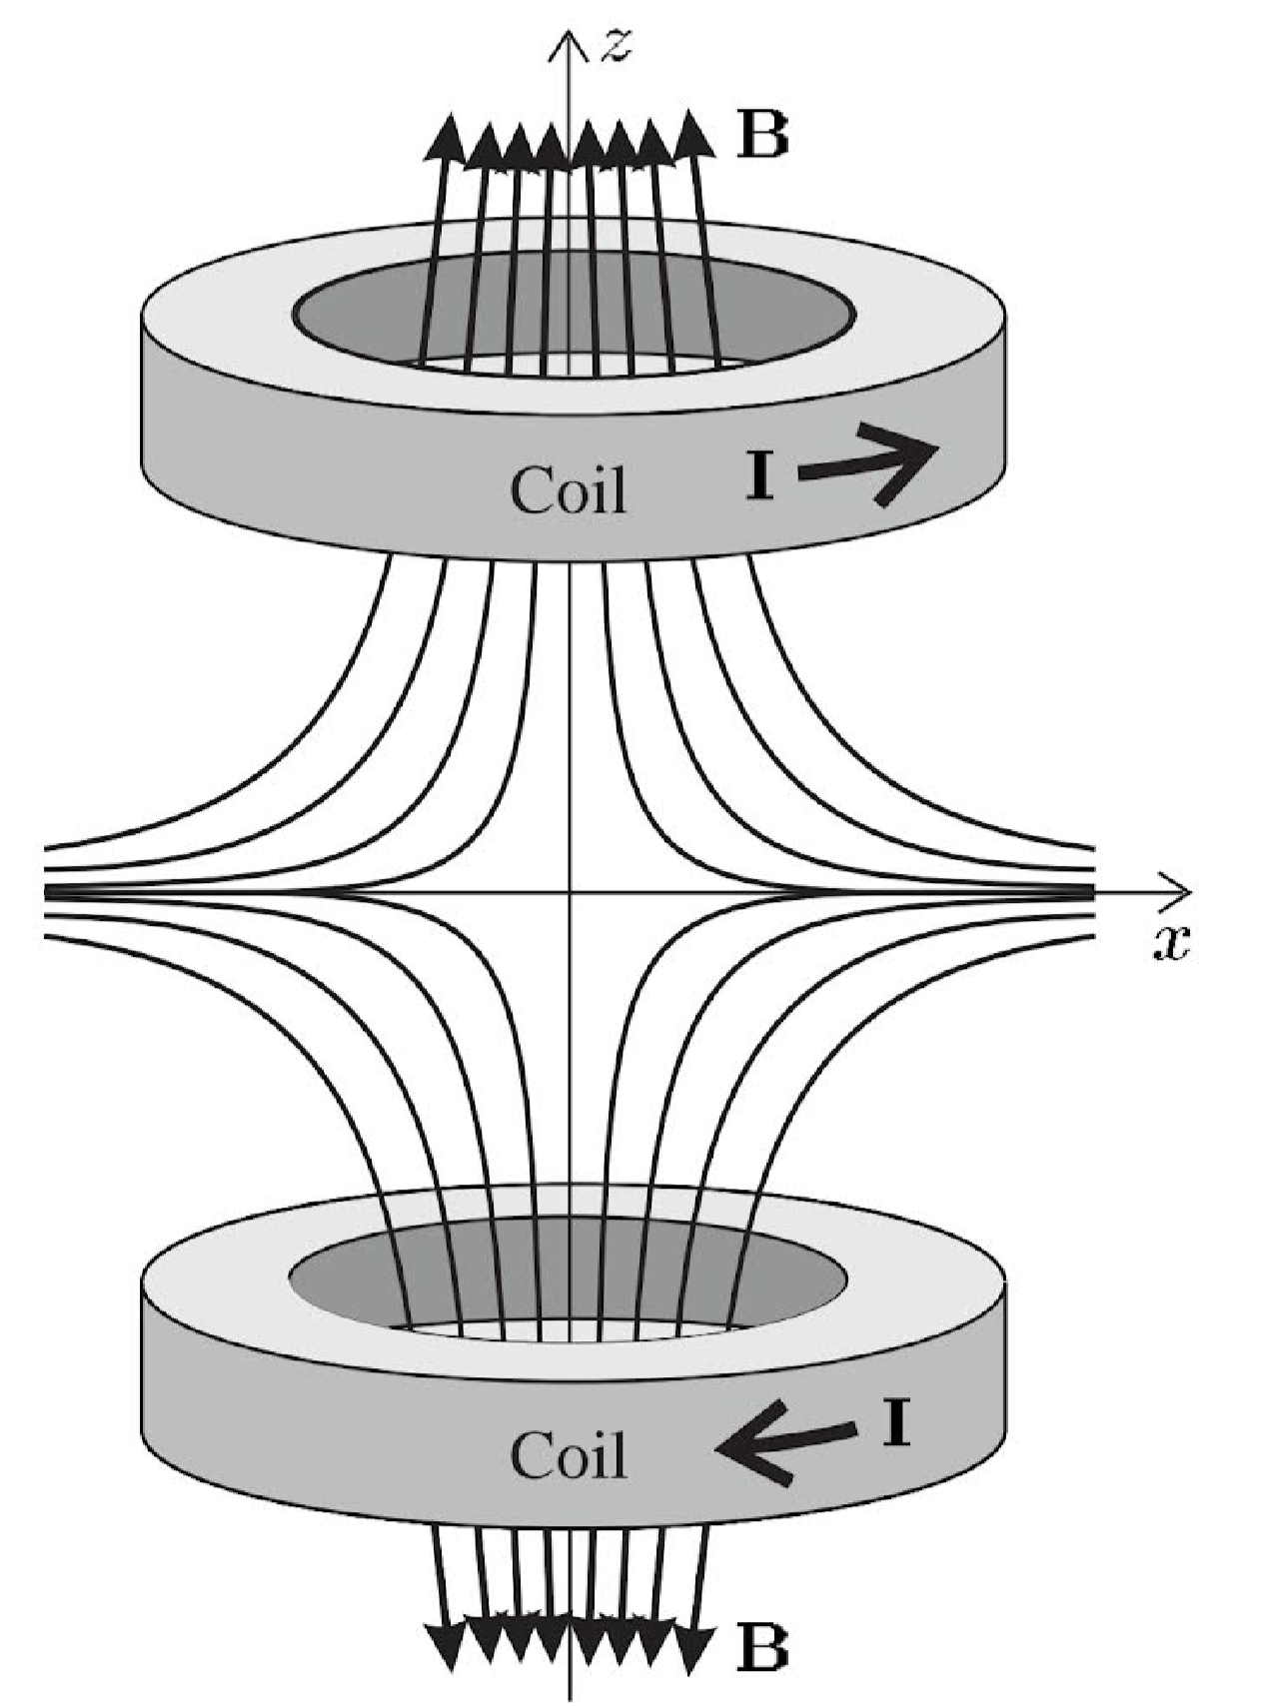
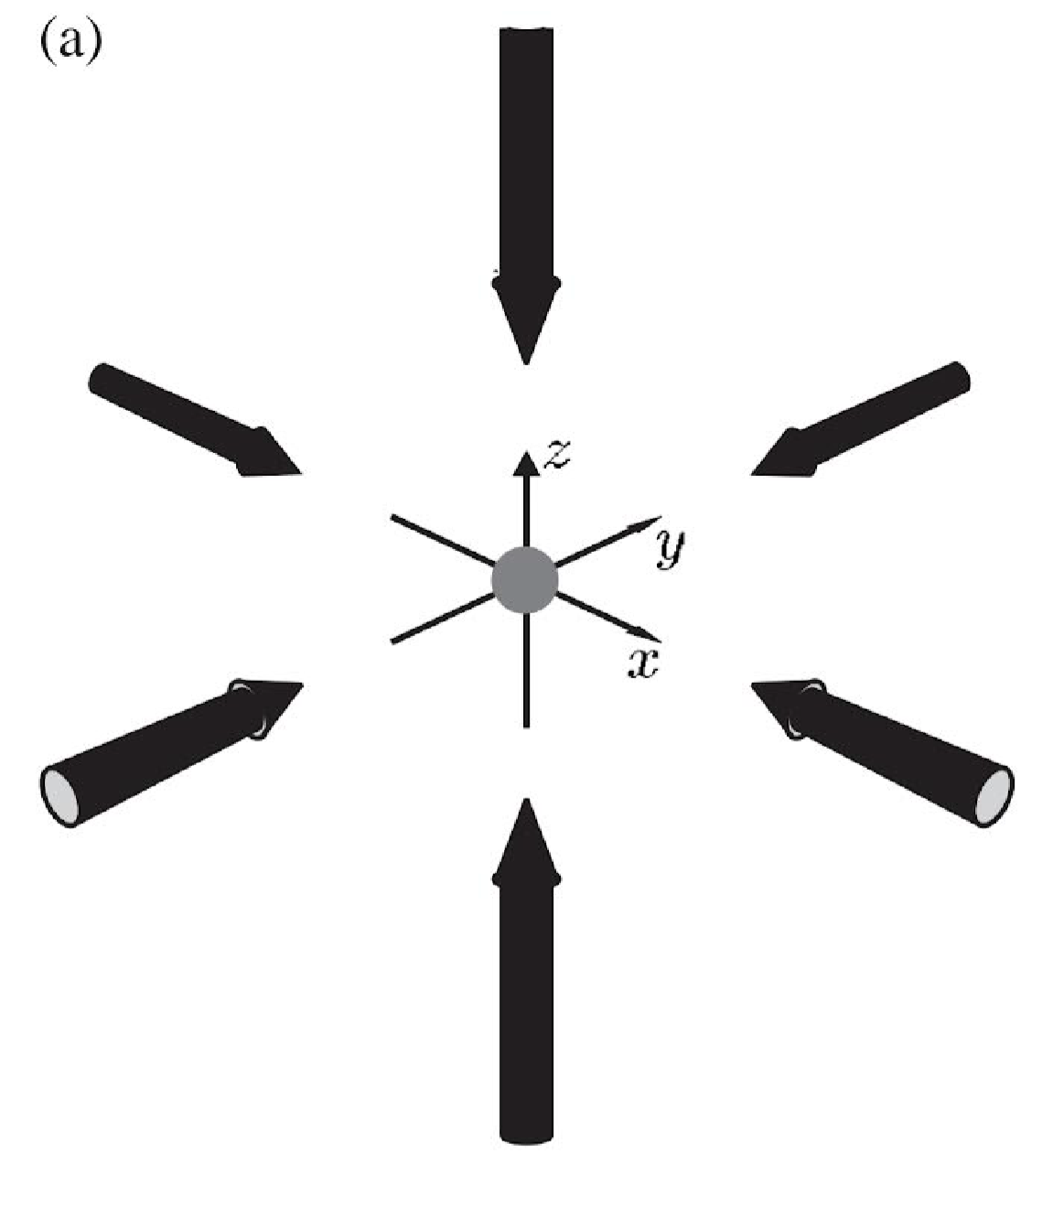
MOT: Magneto-Optical Trap
3 retro-reflected beams
2 coils generating
magnetic field
Atomic Physics, C. J. Foot (2005).
Notes:
magneto: changing Doppler shift is compensated by a spatially varying magnetic field

Slide 6
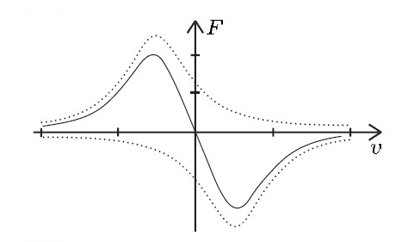
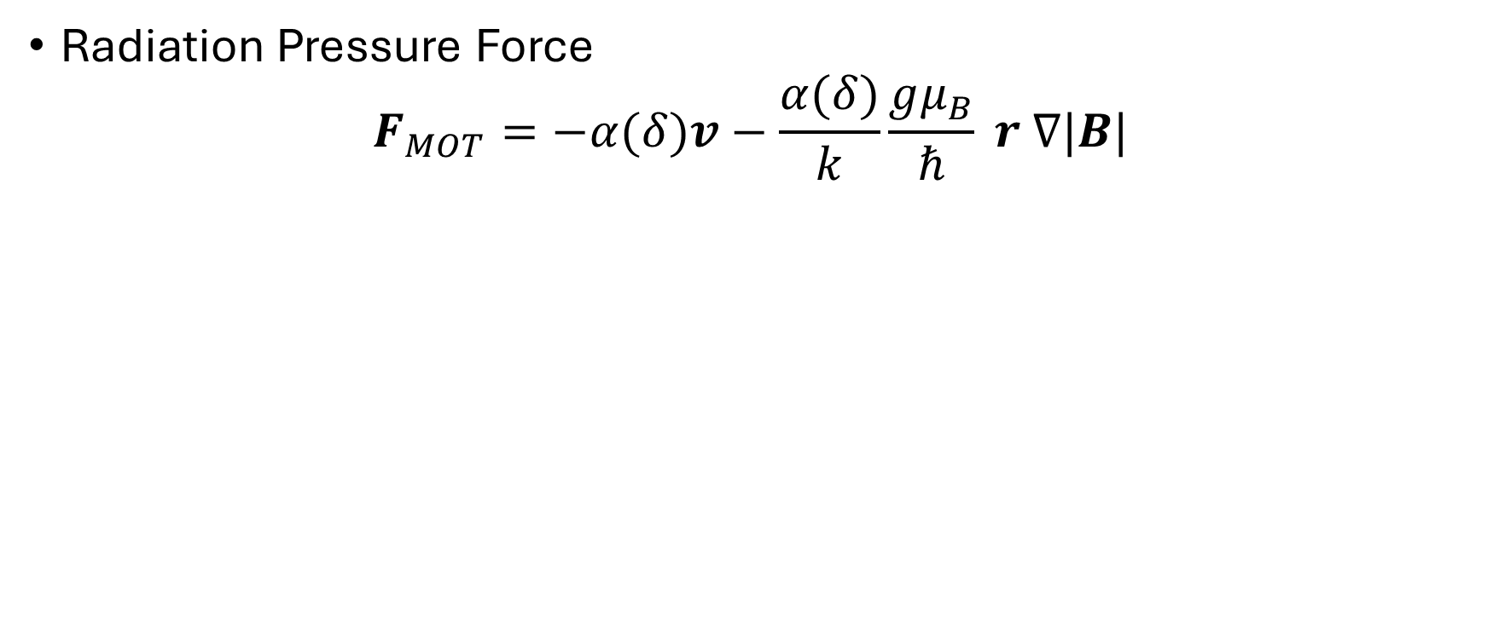
Cooling & Trapping forces
Radiation Pressure Force
$$F_{MOT}=−α(δ)v−\frac{α(δ)}{k}\frac{gμ_{B}}{ℏ} r ∇|B|$$
Frictional force
Trapping force
Notes:
At room temperature, atoms are roughly travelling at 440 m/s (from Equipartition theorem),
A thermal atom possesses momentum that is thousands of orders of magnitude larger than that of a photon (p = h/λ). Thus, cooling involves a multitude of absorption-emission cycles, in each of which the atom looses a unit of angular ℏk.
or an atom irradiated with resonant light, this recoil velocity is typically between 0.3 cm/s and 10 cm/s. For D2 transition in 87-Rb its 3.48m/s. the scattering rate of photons is close to natural linewidth Γ for near resonant light. The deceleration due to resonant is Γ*v_rec $≈$ 10⁷ m/s²

Slide 7
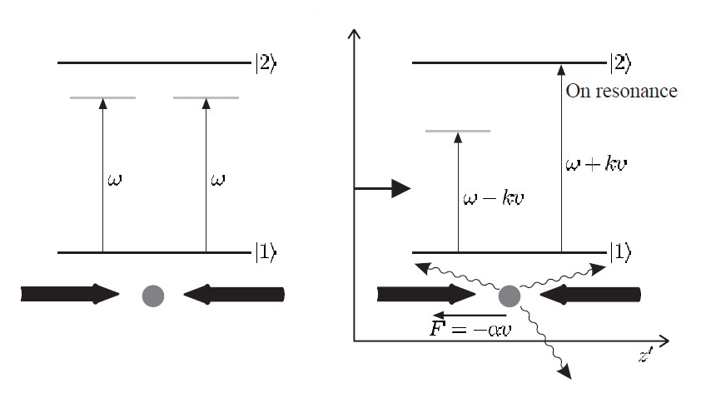
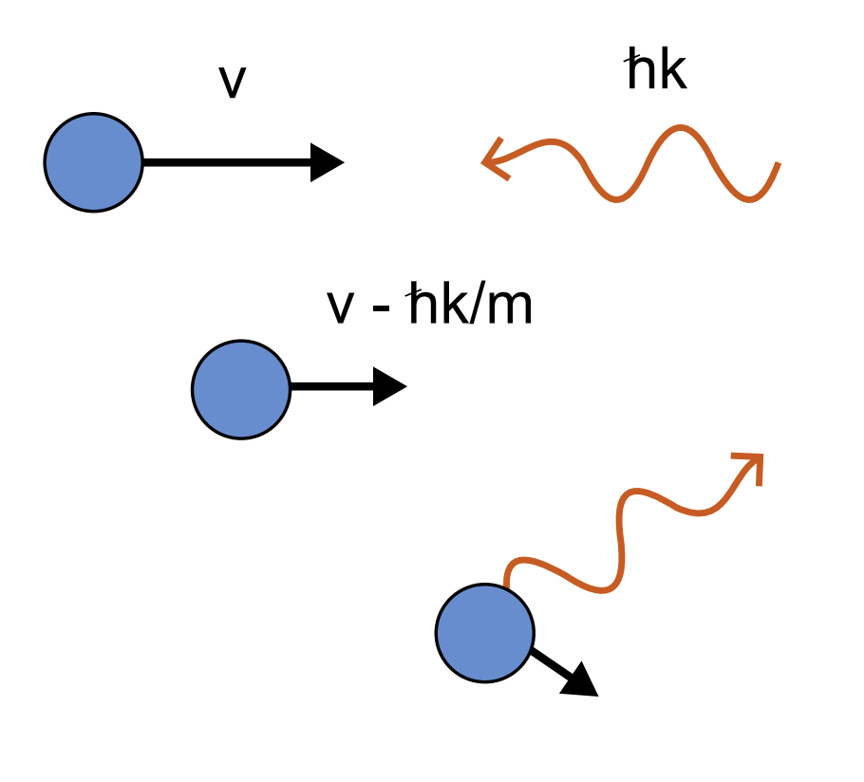
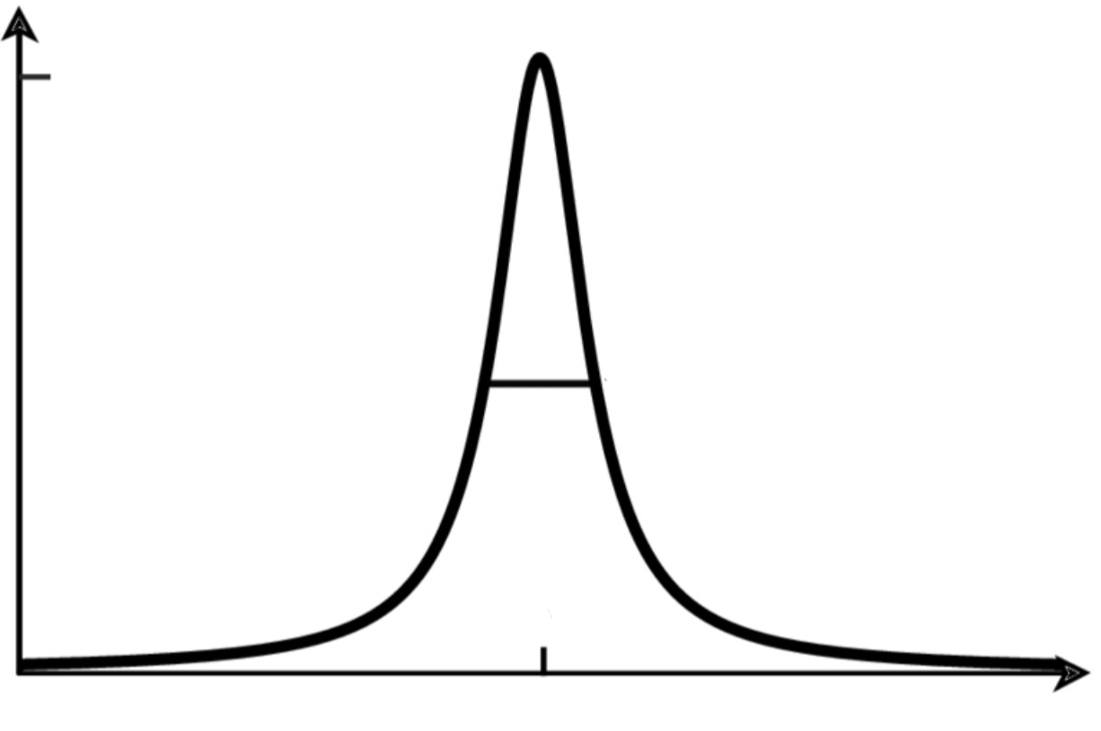
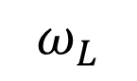


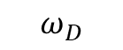
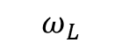
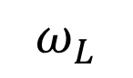
Doppler Cooling
Photon recoil
$$ℏk$$
$$v$$
$$ω_{L}$$
$$ω_{L}$$
Mirror
Scattering Rate
C. Foot (2005)
$$ω_{D}$$
$$ω_{L}$$
Notes:
keep atoms in vapour form and still be very cold: laser cooling
Everytime the atom hits particles of light, they will scatter & everytime the atom scatter these photons, it feels momentum impulses. In this arrangement you think there’s no net force but another thing you have to know is that when the atom is moving to the right it doesn’t see the frequency of the laser
Here ive plotted the response curve of the atom, that is the prob the atom will scatter a photon.

Slide 8
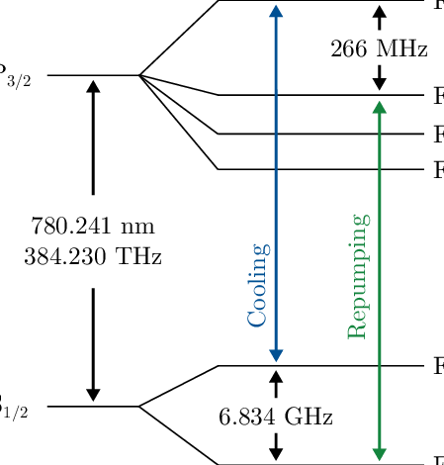
Doppler Cooling
Photon recoil
$$ℏk$$
$$v$$
$$ω_{L}$$
$$ω_{L}$$
Mirror
Scattering Rate
$$ω_{D}$$
$$ω_{L}$$
Notes:
absorption-emission cycles, in each of which the atom
looses a unit of angular ℏk.

Slide 9
Vacuum
Notes:
“chose an atom now → need a cooling mechanism”

Slide 10
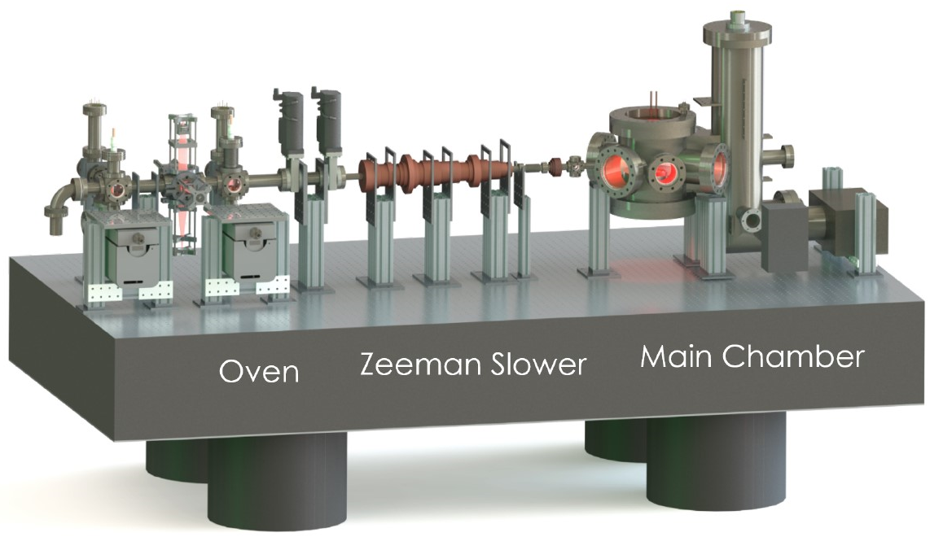
Typical Experimental Apparatus
Ultracold Lithium University of California, Santa Barbara;
PhD Thesis, C. Fujiwara (2019)
Notes:
Ultracold Lithium in Modulated Optical Lattice
MOT requires a UHV vacuum of 10⁻⁹ Torr, while evaporative cooling of atoms in a magnetic trap and many experiments with ultra-cold atoms requires UHV vacuum of 10⁻¹⁰ Torr

Slide 11
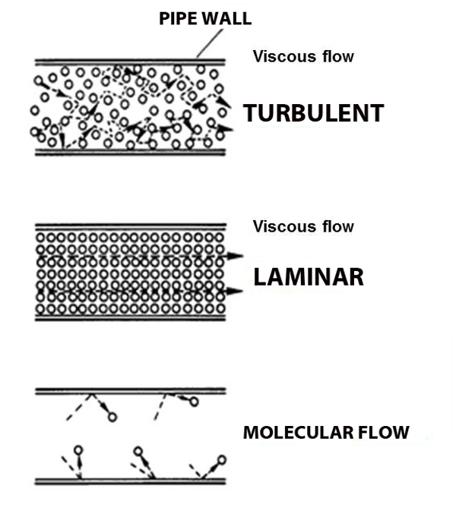
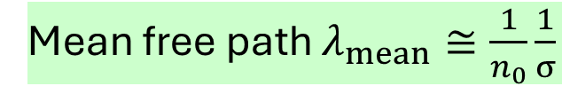
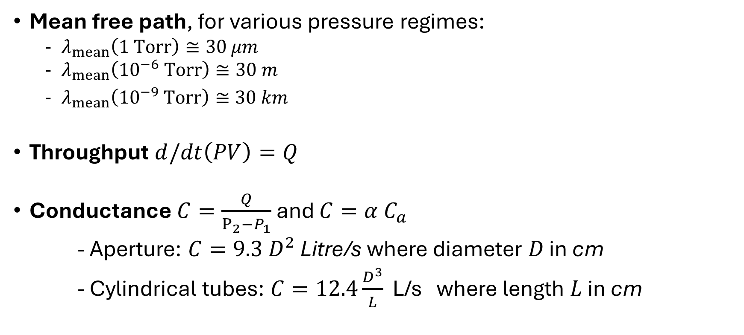
Molecular Flow regime
Mean free path $λ_{mean}≅\frac{1}{n_{0}}\frac{1}{σ}$
Mean free path, for various pressure regimes:
$λ_{mean}\left(1 Torr\right)≅30 μm$
$λ_{mean}\left({10}^{−6} Torr\right)≅30 m$
$λ_{mean}\left({10}^{−9} Torr\right)≅30 km$
Throughput $d/dt\left(PV\right)=Q$
Conductance $C=\frac{Q}{P_{2}−P_{1}}$ and $C=α C_{a}$
- Aperture: $C=9.3 D^{2}$ Litre/s where diameter $D$ in cm
- Cylindrical tubes: $C=12.4\frac{D^{3}}{L}$ L/s where length $L$ in cm
Notes:
Need for vacuum? clean environment for a sufficient MOT lifetime, how long atoms stay in cooling region before they’re kicked out due to background collisions with other gases
Flow regimes characterized by
Reynolds nu Re:
Kn = λ_mean/d d: characteristic dimension of system λ_mean: is the avg distance atom propagate before it collides, quantified by n0:atomic density (from PV=nRT, P from pressure of gas within chamber → n0=P/(kT)) & σ∼=10¹⁴cm2 collisional cross-section (from cmp absorbed intensity with Beer’s law)
Flow regimes:
High pressure –further classified as turbulent (chaotic) or viscous flow (Kn<0.01)
Laminar: when velocity and surface irregularities small enough for gas to flow gently past obstructions
Molecular: (Kn>1.0 Re not defined cuz viscosity is not defined) (@ <10⁻⁴ Torr)
Throughput Q: ddt(PV) = Q. (the volume of gas at a known pressure) that passes a lane in a known time. Throughput is the energy
per unit time crossing a plane. The energy in question is not the kinetic and
potential energy contained in the gas molecules, but rather the energy
required to transport the molecules across a plane. flow of gas in a duct or pipe is dependent on the pressure drop
across the object as well as its cross-sectional geometry
Conductance of a system, C = a*Ca; where a is the transmission probability are calculated using statistical Monte Carlo methods which can be applied to complicated shapes such as conical cross-sections. The maximum pumping speed of a high vacuum pump cannot be larger than the conductance of its aperture (choking/choke the pump) (i.e. C=1/Resist.)
Choked flow is a critical consideration in the design and operation of aircraft engines, particularly in the context of air intake and exhaust systems.

Slide 12
Leaks? Residual Gas Analyzer (RGA)
H2
N2
CO2
O2
Notes:
From the residual gas analyzer (RGA) scans, the partial pressure of H2 gas dominates
the science chamber, followed by N2. H2 is greater than 10−9 Torr, which is an order of
magnitude greater than the partial pressure of the rest of the gases.

Slide 13
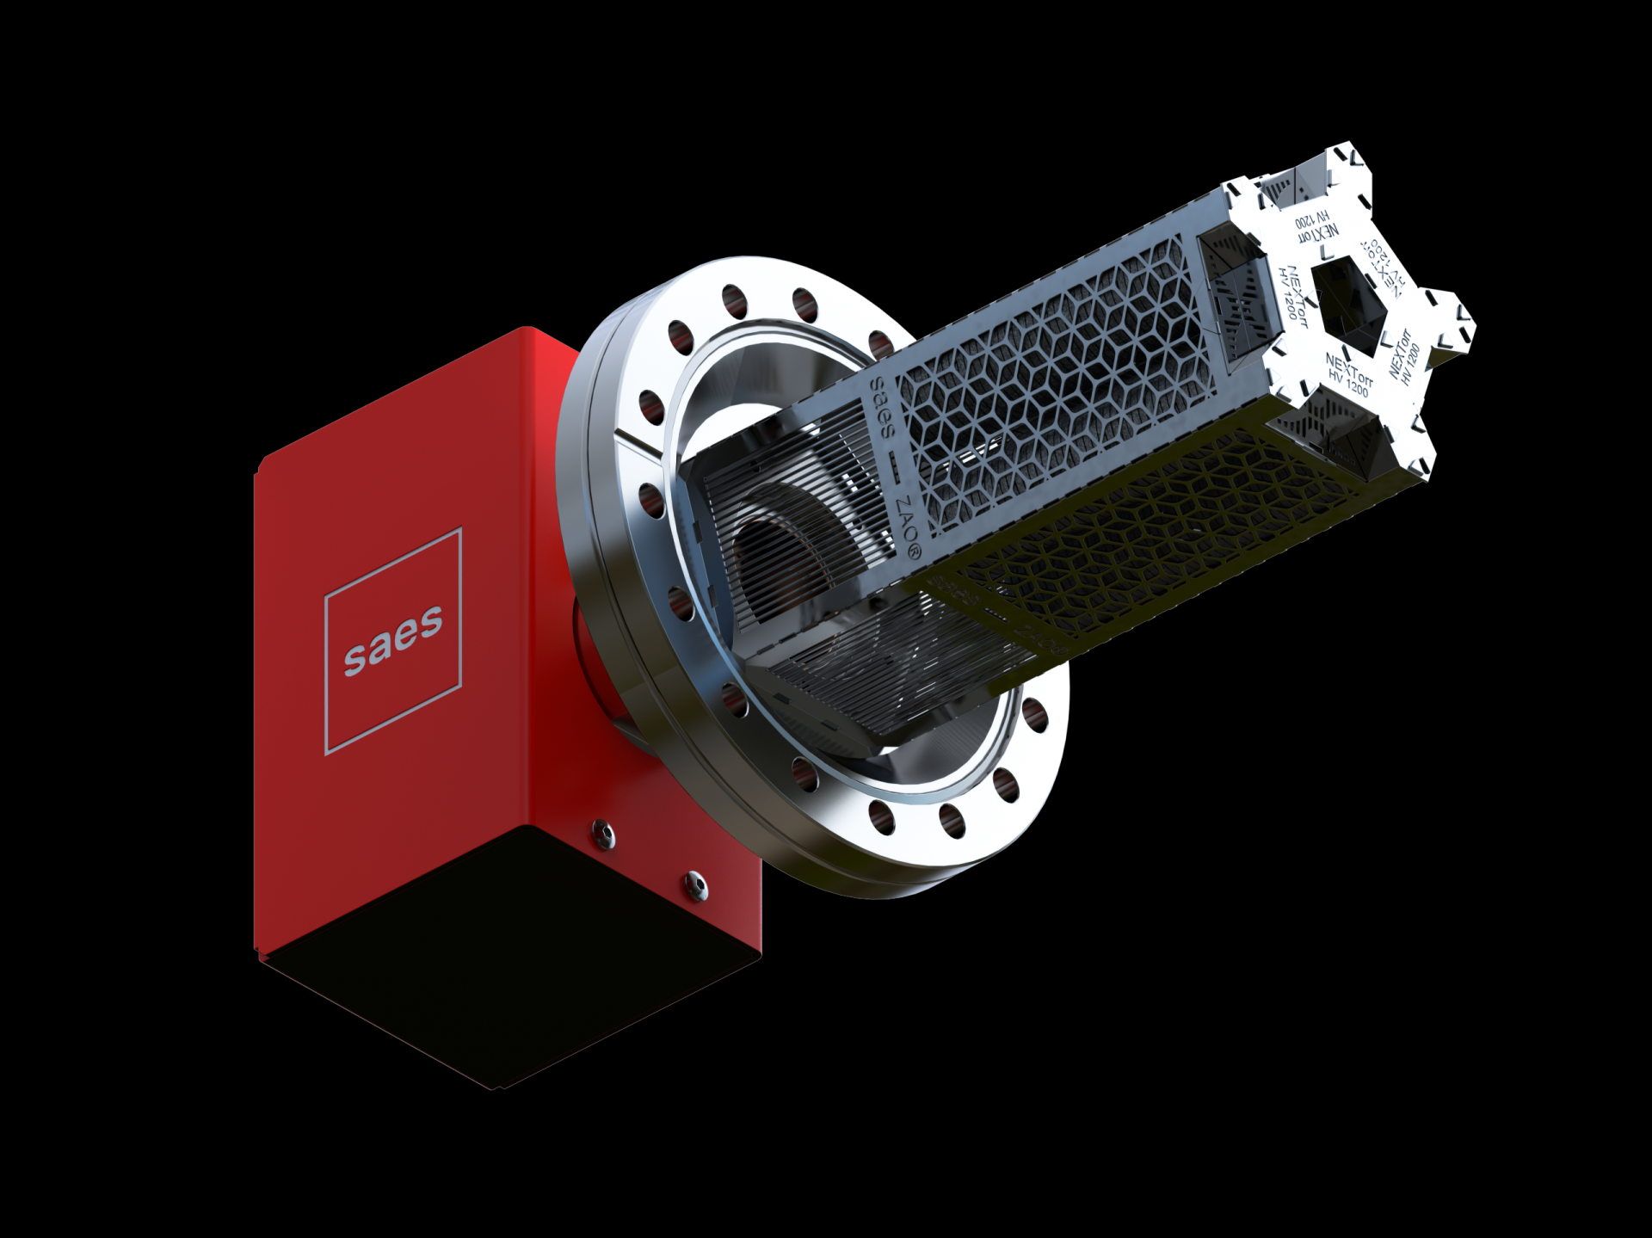
Vacuum System: Pumps
Roughing pump (best 0.01 Torr) → Turbo Pump (10⁻⁶-10⁻¹⁰ Torr)
Ion Pump: Main pump removes the noble gases, primarily Ar (6 L/s) and CH4 (15 L/s)
Non-evaporative Getter (NEG): e.g. Ti-Sub
to boost H2 pumping (byproduct: H2O, CO2, O2 and N2.)
Getters do not pump noble gases as they are not chemically reactive.
SAES
Notes:
Effective pumping speed set by the conductance of the system
Pumps here are oil-free pumps, no vibrations ,i.e. not mechanical pumps (it’s a momentum transfer pump)
===========================
Turbo pump: turbo pump oil has non-negligible vapour pressure (20,000-80,000 rpm ~blade speed 500m/s) ultimate pressure of ~10⁻⁹Torr w/ 1400 L/s pumping speed <<In contrast to other common UHV pumps, such as turbomolecular pumps and diffusion pumps, ion pumps have no moving parts and use no oil. They are therefore clean, need little maintenance, and produce no vibrations. T>>>
=============================
Ion pump: Traditionally, sputter ion pumps, which are used as the main pump, fulfil the pumping
speed requirements and compact getters are used to boost the H2 pumping. their name suggests, ionize the gas and then employs a strong electrical
potential to absorb the atoms on an electrode. The cathode is chemically active and
typically composed of titanium. Ionization works by sputtering the atoms with a getter
material. Typically, turbomolecular and ion pumps are inefficient at pumping hydrogen.
-=======================
Getter pump compact getter material that is porous
at the atomic level
remove gases by chemical reactions that form solid compounds. Hydrogen does not react to form a chemical compound, rather it dissolves
in the bulk of the getter forming a solid solution. (Van der waals)
Also contain a heating element that heats up the getter
material to a temperature depending on the gas to be pumped. Saturated getter lattice
can be regenerated, i.e. activated, by setting the heating element to higher temperatures.
Activation involves heating under vacuum at typical activation temperatures of 400-500oC.
for approximately an hour. Getters can sorb gases after activation without requring power.

Slide 14
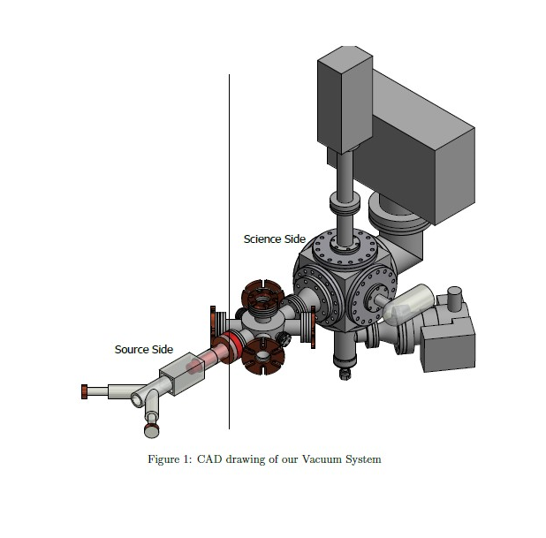
Sample Vacuum System
B. Hsu, Thywissen Lab internal report
Notes:
[BernieHsu] Ref: B. C. Hsu, “About Our Third Vacuum System," Thywissen Lab Summer Report, 08 2018.
Pumping speed >> than conductance
B. Hsu, Thywissen Lab summer report, 08 2018

Slide 15
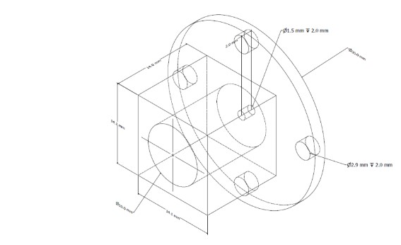
Differential Pumping Stage
Current differential pumping tube with a 1.5mm opening
Notes:
[Hanzhen ug thesis]
“Gas in the 2D-MOT is pumped through the differential tube only. With the current differential pumping geometry, the conductance is calculated to be 0.1L/s”
Aim: based on Fouche’s

Slide 16
Sample vacuum system
getter
Ion pump
(6L/s Ar; 15 L/s CH₄)
“1”
RGA
“3”
Getter
“2”
2D MOT
3D MOT
VAT
³⁹K source
Ion pump (60L/s)
1. Isolation: C₁₂, C₂₃ ‘small’ → P₃ ~ 10⁻³ P₂ ~ 10⁻³ P₁
3. High solid angle of 3D MOT
2. Adequate pumping of 2, 3: C_{P2, 2}, C_{P3, 3}‘large’
i.e. low pressure & high pumping speed
4. Optical access
Notes:
Aim: Differential pumping of the order of 10⁻³ & pressure in science chamber 10⁻¹¹ mbar
The conductance is calculated to be 0.1 L/s for the current geometry
C ~ v *D³/L

Slide 17
Magneto-Optical Trap
Notes:
“chose an atom now → need a cooling mechanism”

Slide 18
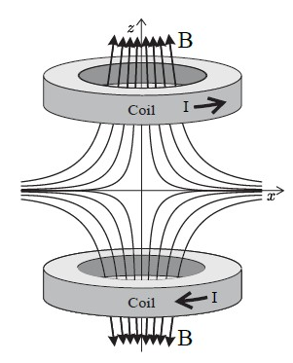
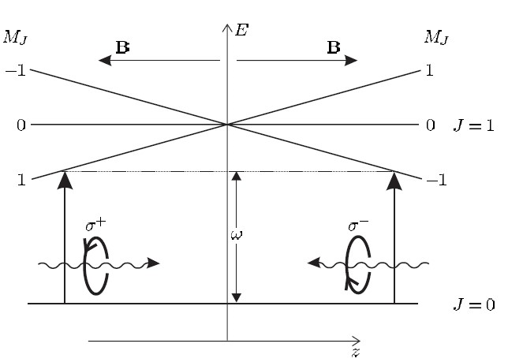
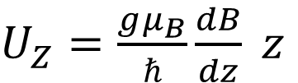
Magnetic Field
B-field gradient
Bias field
Quadroupole field
$B\left(x,y,z\right)=−\frac{b}{2} x \hat{x}−\frac{b}{2} y \hat{y}+(bz+B_{0}) \hat{z}$
Zeeman shift at displacement z provided by the magnetic field is
$U_{Z}=\frac{gμ_{B}}{ℏ}\frac{dB}{dz} z$
C. Foot (2005)
Notes:
A quadroupole magnetic field (for a 3D confinement) generates a spatially-varying Zeeman
shift experienced by the atomic cloud. The magnetic field gradient provides the trapping
force while cooling is attained by the scattering force exerted by σ+ or σ− photons. The
Zeeman shift at displacement z provided by the magnetic field is magnetic field gradient is determined by the number of turns in the coils N
Bias field: displaces the centre of symmetry in the Quadroupole gradient

Slide 19
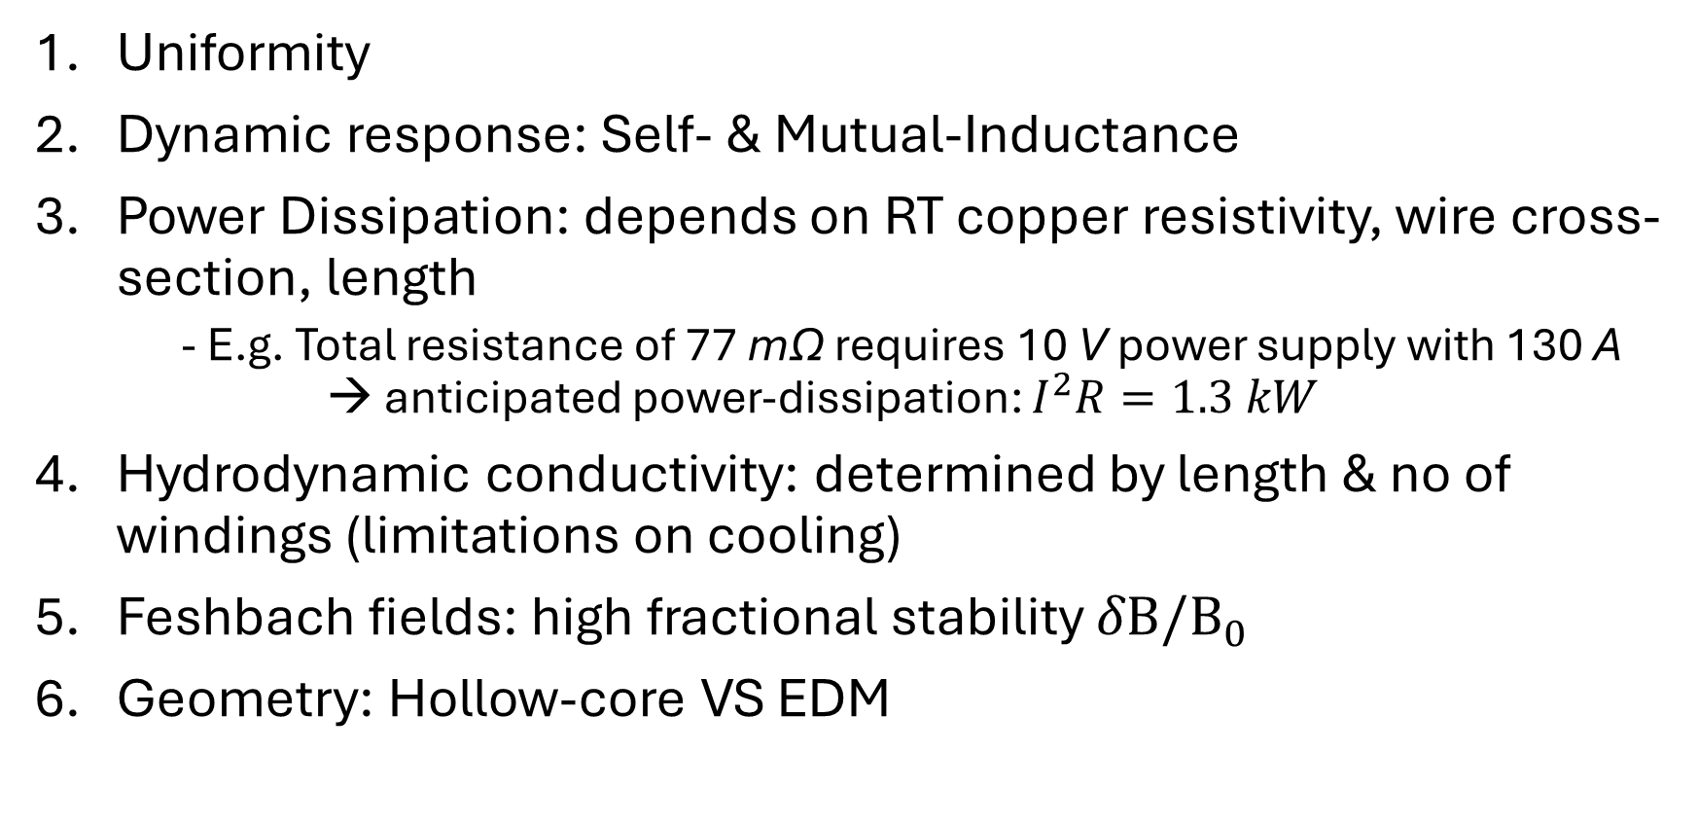
Magnetic Field – Design Considerations
Uniformity
Dynamic response: Self- & Mutual-Inductance
Power Dissipation: depends on RT copper resistivity, wire cross-section, length
- E.g. Total resistance of 77 mΩ requires 10 V power supply with 130 A → anticipated power-dissipation: $I^{2}R=1.3 kW$
Hydrodynamic conductivity: determined by length & no of windings (limitations on cooling)
Feshbach fields: high fractional stability $δΒ/Β_{0}$
Geometry: Hollow-core VS EDM
Notes:
1. magnetic field is required to be flat within the spatial range of the science chamber. Geometric constraint on the coil design is limited by the size of the laser beam and the size
of the chamber.
2. Inductance (BELOW): measure of magnetic flux through the area (cross section) enclosed by current carrying coil
3. Power dissipation: see above
4. Large temperature fluctuations can lead to unreliable magnetic field
5. Larger spirals and more turns limit the limit the cooling. Ideally, the coils should not heat up by more than 5ºC. Rb – 87 has the largest width FB resonance 1007 G with Δ = 170 mG and next one at ~600G with 17mG width → need large fractional stability
FB: largest width Feshbach resonance occurs at 1007 G with a width Δ = 170 mG and the next one is at 600 G with Δ = 17 mG (aside: in situ measurement of the field constrains the field stability. Often, the field inside a vacuum chamber is characterized via transitions between two-magnetic manifold in the trapped atoms, such as with Rabi spectroscopy)
Inductance: determines how quickly you can turn on/off the fields (switching times) L = 2U/I² (inductance: proportional to the energy stored U in the magnetic field for a given current.)
Self-inductance (L): measure of magnetic flux through the area (cross section) enclosed by current carrying coil. Fxn of loop radius r, wire radius R (assuming R/a <<1)
Mutual-inductance: measure of extent of magnetic field leakage bw current-carrying wires, fxn of coil gerometry and separation bw coils | When two circuits carrying time-varying currents are close to one another, the magnetic flux through each circuit varies because of the changing current I in the other circuit. Consequently, an emf is induced in each circuit by the changing current in the other. → can we design a zero mutual inductance pair?
HOW does inductance affect switching times? max rate of change of current possible dI/dt = V_max/2L (not considering mutual inductance)

Slide 20
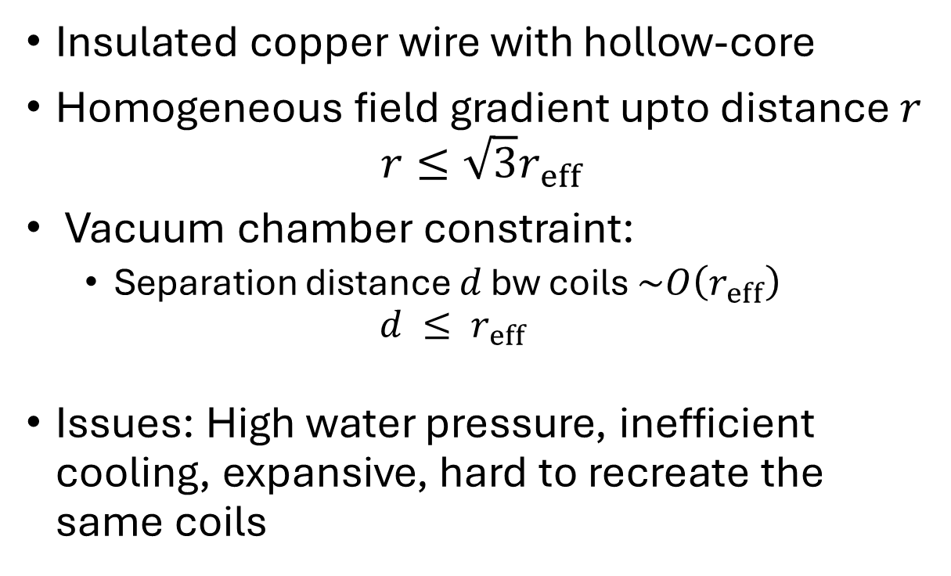
Electromagnets: Hollow-core
Insulated copper wire with hollow-core
Homogeneous field gradient upto distance $r$
$$r≤\sqrt{3}r_{eff}$$
Vacuum chamber constraint:
Separation distance $d$ bw coils $\sim O\left(r_{eff}\right)$
$$d ≤ r_{eff}$$
Issues: High water pressure, inefficient cooling, expansive, hard to recreate the same coils
Jendrzejewski Group U. Heidelberg
Notes:
For a fixed geometry the performance is bound by the power dissipation, based room
temperature copper resistivity and the wire cross-section.
The MOT is achieved by passing equal but opposite (e.g.~6) A DC currents through each coil. (The wire is hollow to allow the flow of pressurized cooling water through the centre of the wire) A homogeneous field gradient is observed up to a distance of $r =√3reff$where $reff$ is effective radius of coil.

Slide 21
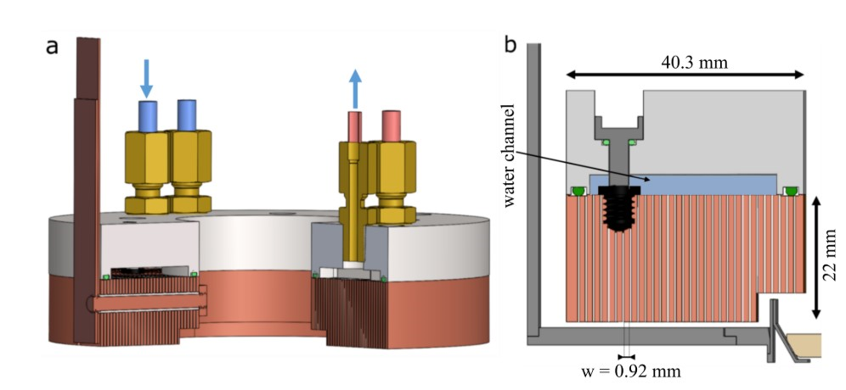
Electromagnets
Bulk-machined electromagnet (EDM 6Ethylene Propylene Diene Methylene rubber)
Brantut Group - ETH Zurich
Notes:
- Switching bw Helhomtz and anti-Helhomtz configuration → can remove any bias magnetic field in
- constraints for coils:
uniformity: we’re probably not going to be centred gradient (Field due to finite size loop).
Achieving the Feshbach field (a bit more than that)
For finite sized coils,…. What geometry will exactly vanish the curvature… coz 2b = R won’t hold for all the loops
Calculation of inductance… 0.5Li^2 = magnetic field energy integrated over all volume
Switch: Turn on off quickly -- FET?
Power dissipation: Use I^2 R to calculate power disspiation
Temperature (Don’t want coil to heat up by more 5 degrees) copper resistivity (check on company websites from where we buy coils)..
Hydrodynamic conductivity… when we make them longer (or more turns), it becomes difficult to cool
Geometry: Cross section of wire, assume it’s made of copper.. Room
Hollow VS EDM - difference ???
Has to fit and allow for optical access
How much voltage we need and how much current we need…. Voltage might increase if we need to switch it on/off quickly
References:
Marcu’s thesis… chip lab.. first thesis…
4 point measurement
Fraction of litre per second..
Straw (hole in copper wire)… hollow core stuff
Or water going on top (can leak,,, top part cool, bottom part hot.. thermal conductivity…. Field temperature and time dependent— becomes unreliable )
EDM paper…. Cool the side farther from atoms
Self inductance of coil… also mutual inductance of the two coils
High current is easy to measure and stabilise it….

Slide 22
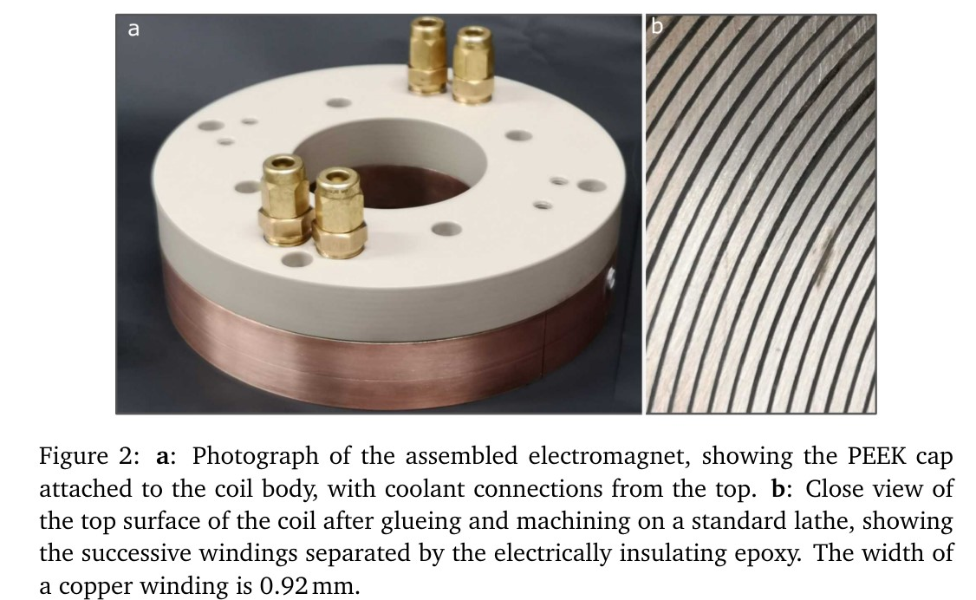
K. Roux, t, SciPost Physics 6 (2019)

Slide 23
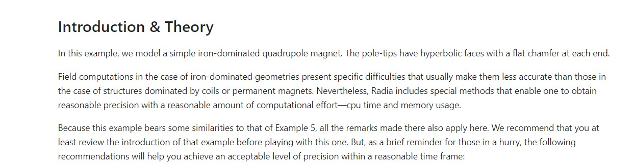
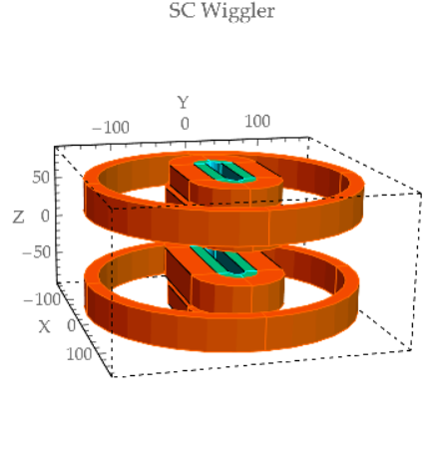
Radia: Quadroupole Magnet
Credits: github.com/ochubar/Radia

Slide 24
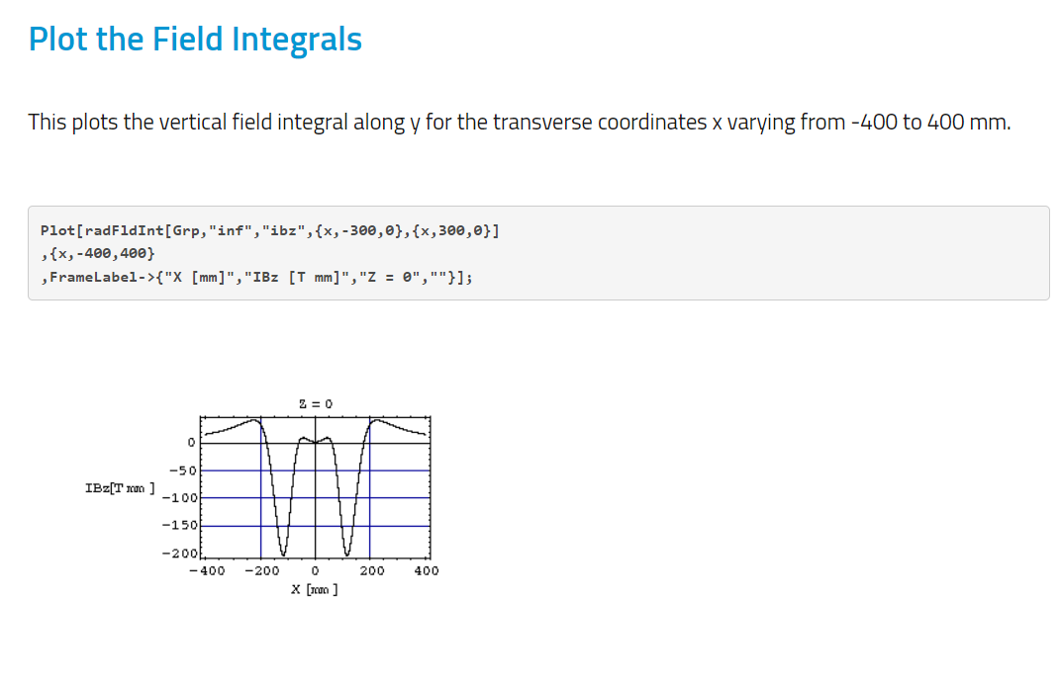
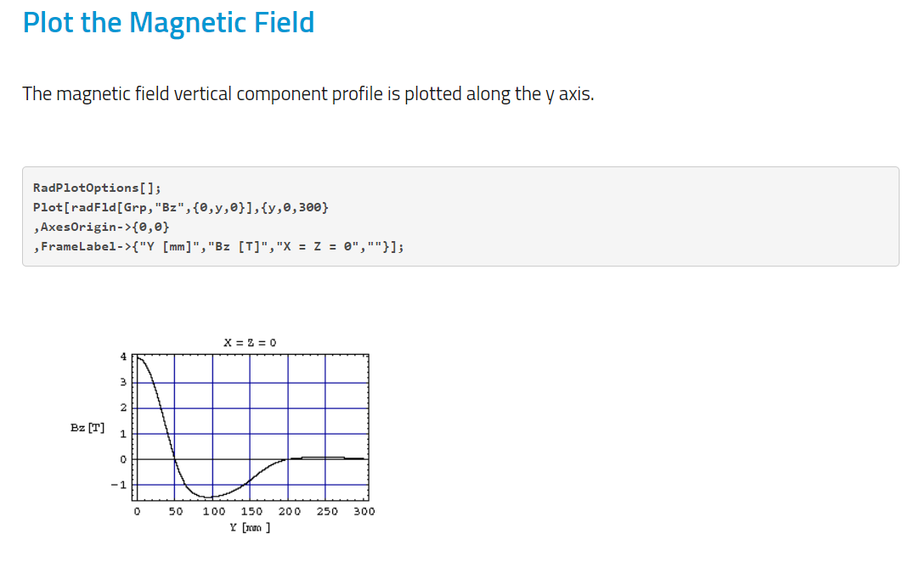
Radia
Credits: github.com/ochubar/Radia

Slide 25

Limitations: $n, T$
Notes:
“chose an atom now → need a cooling mechanism”

Slide 26
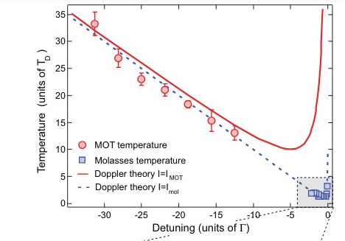
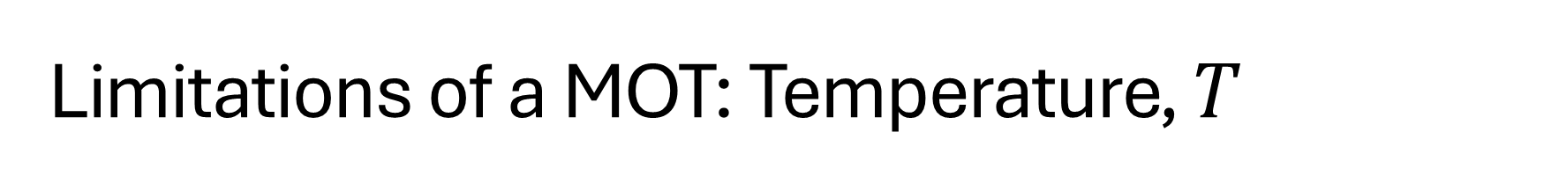
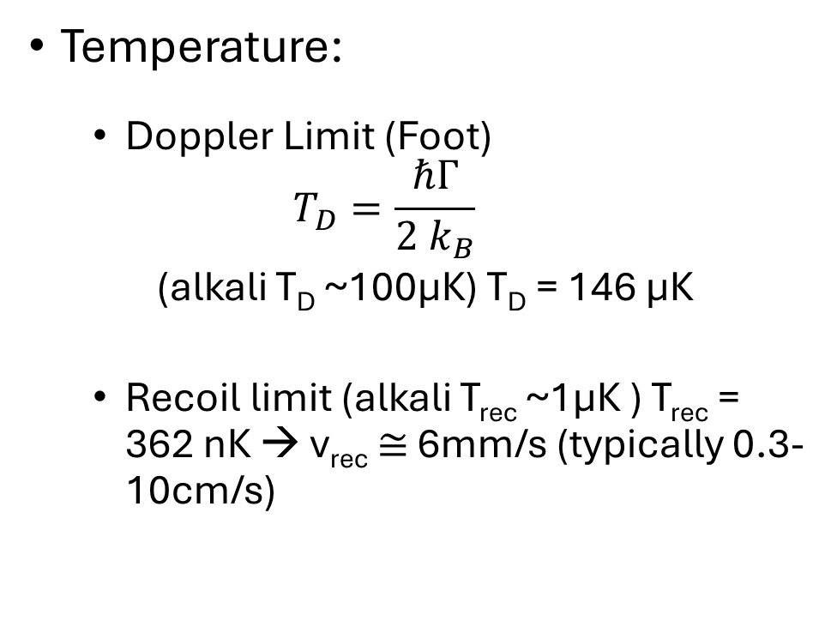
Limitations of a MOT: Temperature, $T$
Temperature:
Doppler Limit (Foot)
$$T_{D}=\frac{ℏΓ}{2 k_{B}}$$
(alkali T_{D} ~100μK) T_{D} = 146 μK
Recoil limit (alkali T_{rec} ~1μK ) T_{rec} = 362 nK → v_{rec} $≅$ 6mm/s (typically 0.3-10cm/s)
R. Chang et al. (2014)
Notes:
minimum temperature at a detuning δ = −Γ/2 as predicted by Doppler cooling theory
At the recoil limit the de
Broglie wavelength roughly equals the wavelength of the cooling radiation,
$$λ_{dΒ}\sim λ_{light}$$
FOOT: Typically, the optical molasses technique can reach temperatures
that are an order of magnitude above the recoil limit, but still well
below the Doppler cooling limit 63Heavy alkalis such as Cs and Rb have
a very low recoil limit and these elements
can be laser cooled to a few
μK. Such temperatures can only be
achieved in practice when stray magnetic
fields that would perturb the MF
states are carefully controlled—a Zeeman
shift μBB comparable with the
light shift U0 will affect the Sisyphus
cooling mechanism, i.e. if μBB ! U0.
For U0/kB = 3μK this criterion implies
that B < 5 × 10−5 T, which is an order
of magnitude less than the Earth’s
magnetic field (5 × 10−4 T)
You don’t really reach the Doppler temp… WHY? (lingering B-fields)
One of the few cases where experiments outperformed theoretical bounds

Slide 27
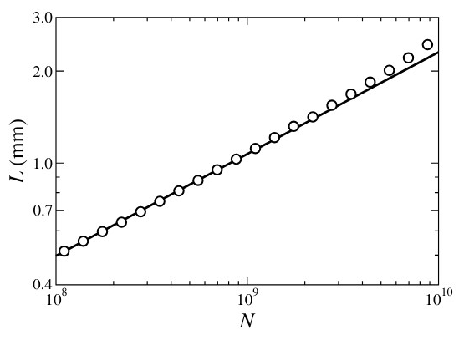
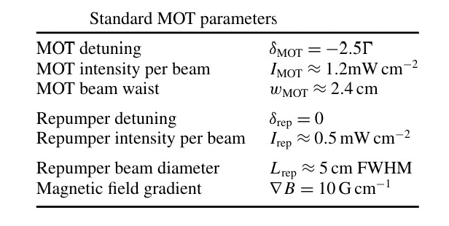
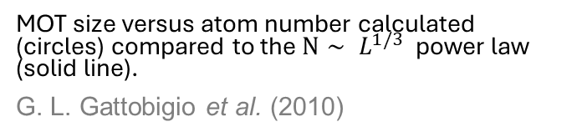
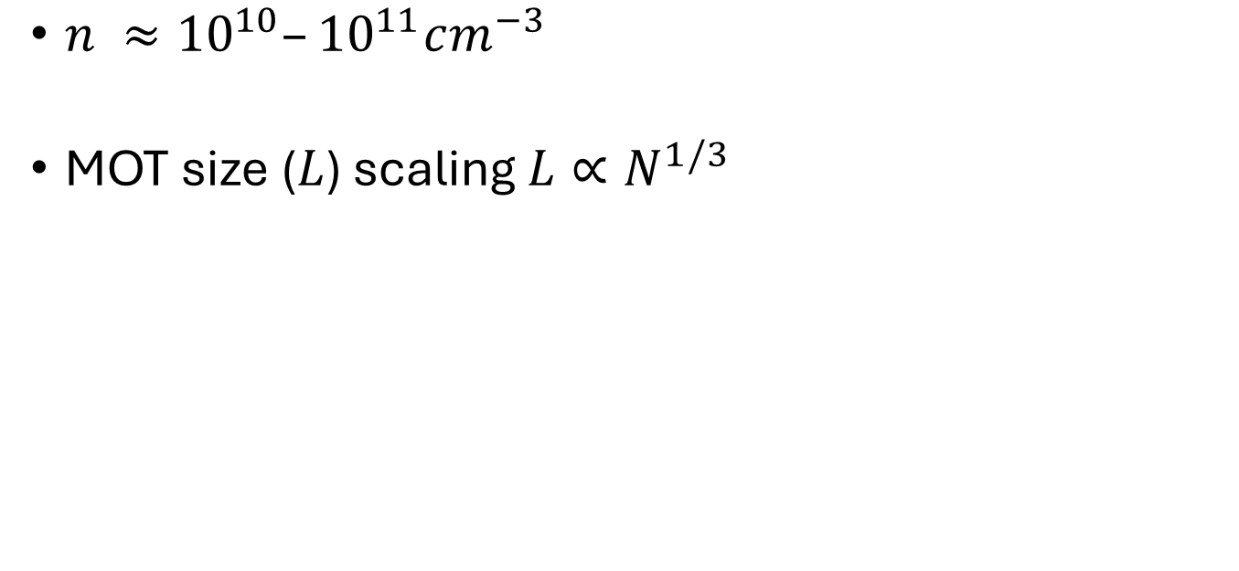
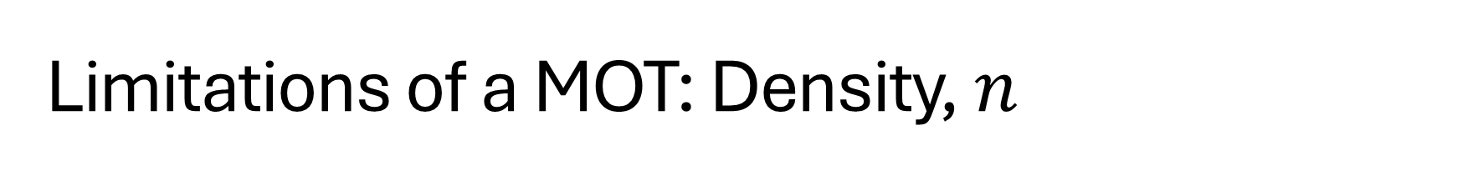
Limitations of a MOT: Density, $n$
$n ≈{10}^{10}–{10}^{11}cm^{−3}$
MOT size ($L$) scaling $L∝N^{1/3}$
MOT size versus atom number calculated (circles) compared to the $N∼ L^{1/3}$power law (solid line).
G. L. Gattobigio et al. (2010)
Notes:
The spatial densities achievable in standard magneto-optical traps (MOTs) have thus been limited to about n ≈1010–1011cm−3 , and increasing the number of atoms N in such a MOT results in a MOT size (L) scaling as L ∝ N 1/3 , which corresponds to a constant density n∼N/L 3 . These density-limiting effects have been… For very large MOTs, the confining force might also become nonlinear (anharmonicity of the trap) - http://www.kaiserlux.eu/coldatoms/Articles/size2010.pdf
photons. A re-irradiated photon by one atoms can be absorbed by another atom.
The larger the density the less likely a spontaneously emitted photon will leave the cloud.
The re-emitted photon also exert a repulsive force. This is because when one atom emits
a photon and another absorbs it, the relative momentum of the atoms increases by 2ℏk.
The net repulsive force results in expansion of the cloud size and imposes a limit of the
atomic density. Generally, the MOT size L scales as L ∝ n1/3. - my MSc thesis

Slide 28
Measurement & Optimization: n, temp

Slide 29
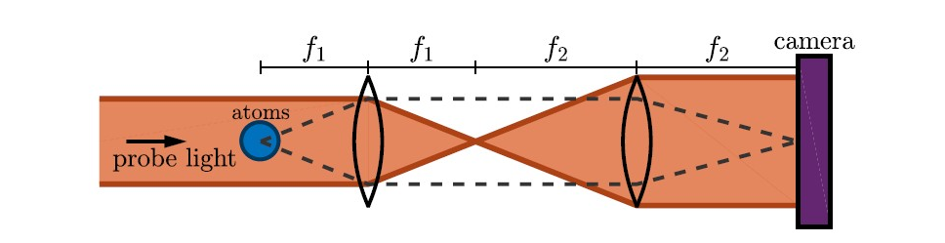
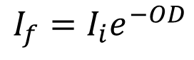
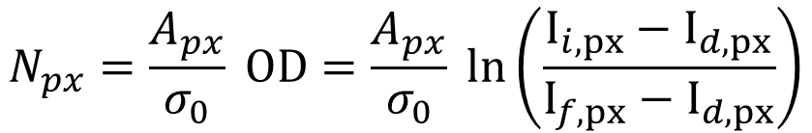
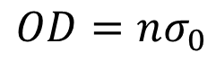
Imaging System: Absorption Imaging
Absorption imaging
$$I_{f}=I_{i}e^{−OD}$$
$$OD=nσ_{0}$$
Discretization of OD yields the number of atoms for a given pixel $N_{px}$
Physical area at location of atoms
$$N_{px}=\frac{A_{px}}{σ_{0}} OD=\frac{A_{px}}{σ_{0}} ln\left(\frac{I_{i,px}−I_{d,px}}{I_{f,px}−I_{d,px}}\right)$$
Measured bg pixel intensity per pixel (common mode noise)
Map atomic spatial distribution: $4F$ imaging system
PhD Thesis, C. Fujiwara (2019)

Slide 30
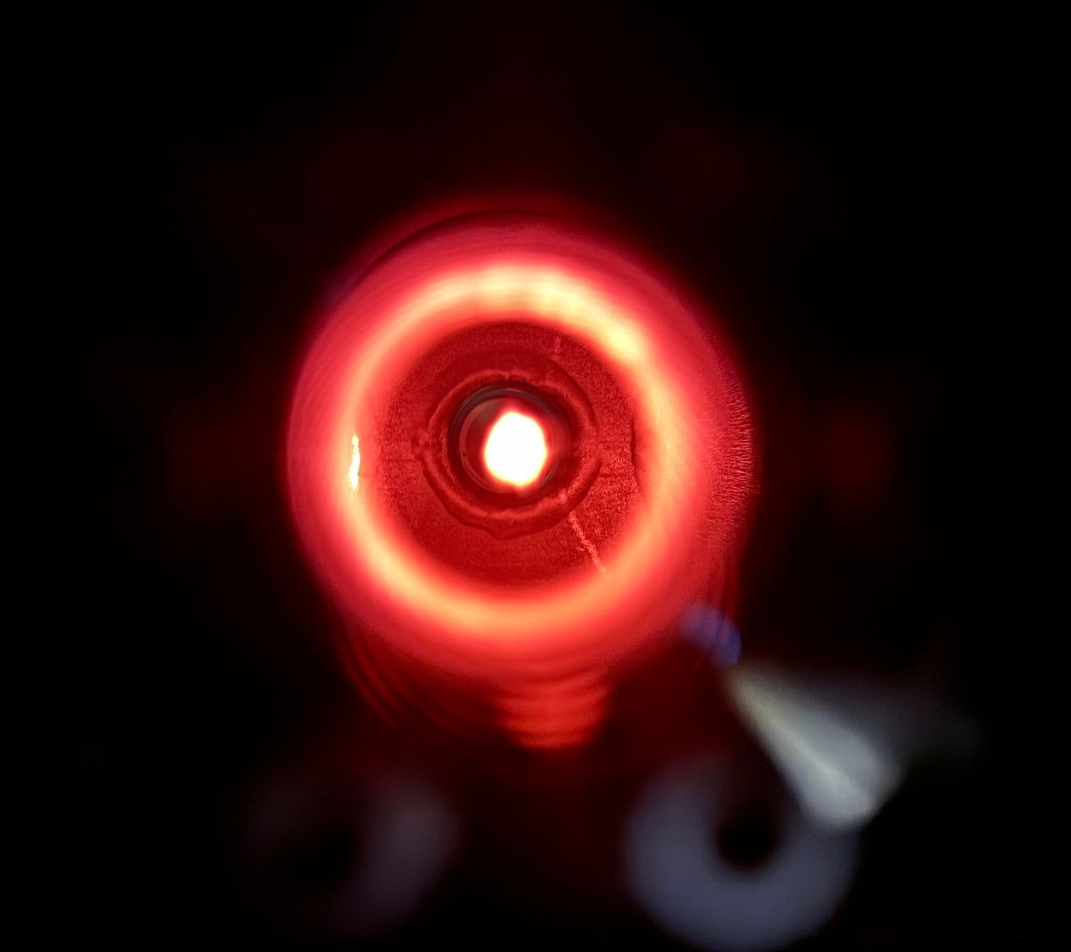
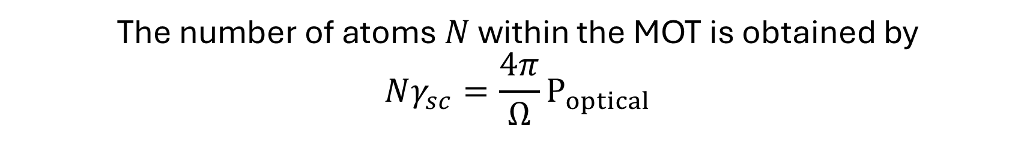
Fluorescence Image
The number of atoms $N$ within the MOT is obtained by
$$Nγ_{sc}=\frac{4π}{Ω}P_{optical}$$
Notes:
No. of Atoms Estimate using Fluorescence Imaging: NEED TO CALIBRATE THE CAMERA.
where Poptical is the total power and Ω is the solid angle of captured by the camera and
only a part Ω/(4π) of the emitted light lands on the solid angle Ω = πr2/d2 with r as the
size of the MOT and d is the distance between the MOT and camera lens –MSc thesis

Slide 31
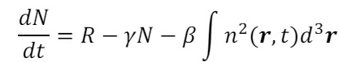
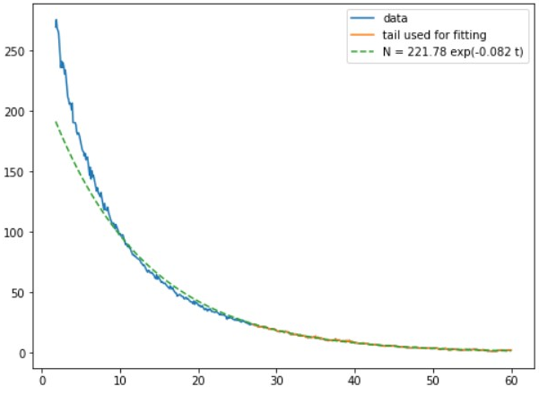


Characterization – Trap Dynamics:
After blocking 2D MOT beams
After unblocking 3D MOT beams
Avg Intensity in ROI
Avg Intensity in ROI
$$N=221.8e^{−0.082 t}$$
Time (s)
Time (s)
Lifetime
Loadtime
Notes:
Avg intensity in ROI after blocking 2D MOT Loadtime: 5-8seconds
Lifetime: just fit to the ‘tail’ of the decay that we observe (see the half-life graphs) because the decay that is observed at the very beginning isn’t exponential . (stronger MOT beams → better trapping) Schreck: The MOT lifetime is limited by
• collisions of MOT atoms with the room temperature background gas
• light-assisted collisions: loss of atoms by mcl production through photo-association
Loadtime of a MOT =/= loadtime WHY? Loadtime (e.g. 1-8 sec) tells about geometry of the vacuum system i.e. atomic flux; lifetime (~15-30 sec) about intensity in 6 MOT beams, detuning of MOT beams
dN/dt =~ N → exponential decay Ref: my msc thesis
Estimate the loading rate $R$ of atoms into the MOT at which atoms with speeds below $v_{c}$ pass through the bounding surface of the MOT (area$∝D^{2}$ )
$$R∝D^{2} \int_{0}^{v_{c}}{v P\left(v\right)}∝D^{4}$$
where velocities of atoms in from the high-temperature vapour are nominally distributed according to MB $P\left(v\right)∝v^{2}e^{−mv^{2}/k_{B}T}$

Slide 32





Ballistic Time-of-flight (TOF) thermometry: $insitu$ $x$ and $p$ distribution
Temperature of initial cloud $σ_{x}$ is related to the cloud size
Cloud size
$$σ\left(t\right)=\sqrt{\left(\frac{k_{B}T}{m}\right)t^{2}+σ_{x}^{2}}$$
Gaussian radius of momentum distribution $σ_{p}∝$ T (eqp thm)
Gaussian radius of probability distribution for positions $σ_{x}$
PhD Thesis, C. Fujiwara (2019)
Notes:
Turn off all the D2 beams, then the magnetic field → atoms ballistically expand within a few ms
Then, the expanded cloud is imaged by shinning resonant light beam, that is the 3D trap and repump DP AOM is zero-detuned.
Technique description: turning o the forces trapping the atomic cloud and measuring the
atomic motion in free expansion suddenly

Slide 33



Thank you!

